Slide 1


Team project Data Science and Machine Learning software foundations
Mariya Kolesnikova (TEAM 6)

Slide 2
GoaL of the TEAM assignment: TEAM ROASTER:
To highlight our team project and demonstrate our ability to apply the knowledge gained during the DSI certificate course to create real-world value .
David Vaz (davidvaz77)
Niccolo Anjello Alcancia (nalcancia)
Mariya Kolesnikova (MK-DSI)
Markus Amalanathan (jeffey97)
Olga Mineyeva (olga-mineyeva)
https://github.com/davidvaz77/team6-project
12 slides total

Slide 3
DATASET
Disease Prediction Using Machine Learning
Use Machine Learning and Deep Learning models to classify 42 diseases !
https://www.kaggle.com/datasets/kaushil268/disease-prediction-using-machine-learning
This dataset has 132 parameters on which 42 different types of diseases can be predicted.
Content
Complete Dataset consists of 2 CSV files . One of them is training and other is for testing your model.
Each CSV file has 133 columns. 132 of these columns are symptoms that a person experiences and last column is the prognosis.
These symptoms are mapped to 42 diseases you can classify these set of symptoms to.
Symptoms are present in a binary system Yes -1 or No -0

Slide 4
Business case
Evaluate if number of symptoms can be reduced from 132 to a lower number without significant alteration of an ability to predict prognosis for all 42 diseases using remaining symptoms. To reduce time needed for patient triage and to reduce a burden on a patient and a clinician through reduction of required clinical information.

Slide 5
APPROACH
Understand dataset. Clean up data (any missing values, mismatched columns, columns with no data etc). Standardization if needed. Ensure that test and training seta are comparable and adequate (No extra data in only one set)
Identify and evaluate suitable models for analysis of the dataset, including:
machine learning/feedforward neural networks
logistic regression
random forest
k-nearest neighbors (KNN)
Create pipeline to test various hyperparameter settings for each model
Identify most and least important features (symptoms) for each model
Through iterative model training and optimization, evaluate if the number of features (symptoms) can be reduced while preserving minimal impact on precision and recall in validation and test sets. Assess accuracy and precision score F1 for evaluation of the models with reduced number of features. Visualize data.

Slide 6
DATA PREPARATION
Removed extra column 'Unnamed: 133' present only in the training set
Removed column 'fluid_overload’ with all symptoms equal to 0 in all subjects in both training and test sets
No missing data was observed
Despite having 132 symptoms, many diseases shared common symptoms, indicating potential redundancy. For example, the common cold had an average of 16.6 symptoms, while some diseases, like Hepatitis D and E, shared up to 9 symptoms.
Set was split into training and validation using sample stratification approach to ensure representation

Slide 7
METHODOLOGY
Baseline Models: Logistic Regression and Feedforward Neural Network models were trained using all 132 symptoms, yielding near-perfect predictions due to low variability in the dataset. Model performance and parameters were visualized (accuracy, loss)
Symptom Minimization: Recursive Feature Elimination (RFE) was used to iteratively reduce the symptom set to sizes of 80, 90, 100, and 120. Models (Logistic Regression, Random Forest K-Nearest Neighbours (KNN), and a Feedforward Neural Network) were retrained and evaluated on these reduced sets to assess the impact on performance.
Metrics: For model evaluation and selection, we prioritized accuracy and the F1 score. Accuracy provides a general measure of overall model performance, while the F1 score balances precision and recall, making it particularly useful when false positives and false negatives have differing levels of importance. By using both metrics, we aim to identify models that maintain high accuracy while minimizing the impact of misclassifications, ensuring robustness across the diverse conditions represented in the dataset.
Cross-Validation: To ensure robustness, 5-fold cross-validation was conducted during training.

Slide 8
MODEL PARAMETERS
Logistic Regression solver=lbfgs C=0.1 | Random Forest n_estimators=200 , _max_depth=150
K-Nearest Neighbors (KNN) k=7 , weights=distance | Feedforward Neural Network 2 hidden layers of 64 and 32 nodes, dropout=0.3, Adam optimizer
Tools and Libraries
Python: numpy, pandas, scikit-learn, keras. Collaboration: Git/GitHub for version control

Slide 9
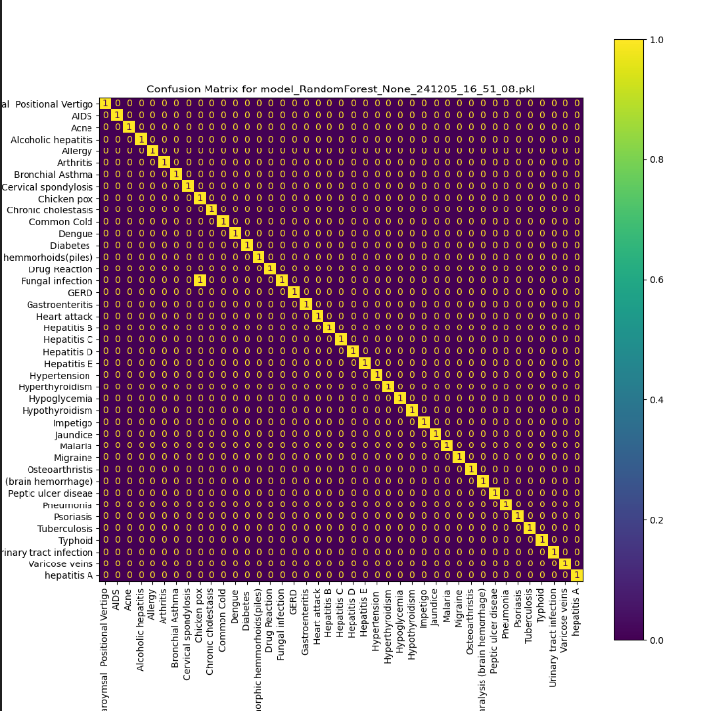
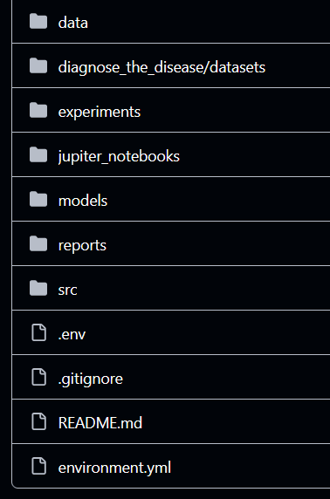
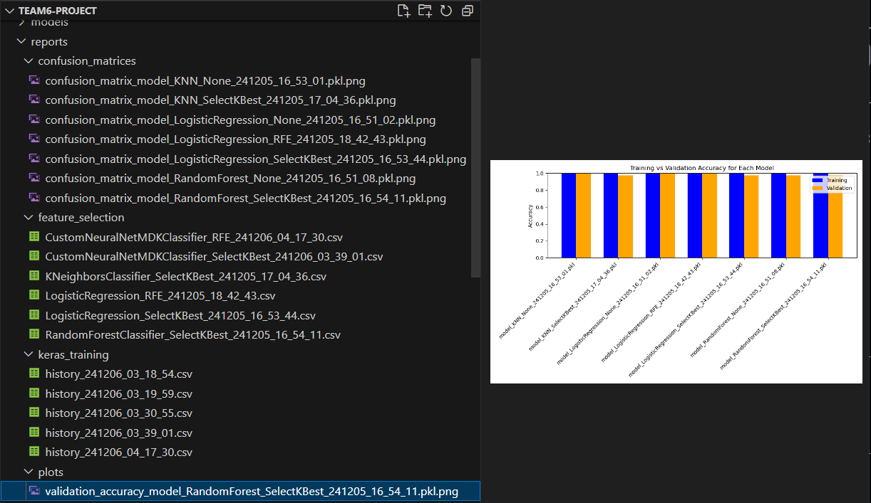
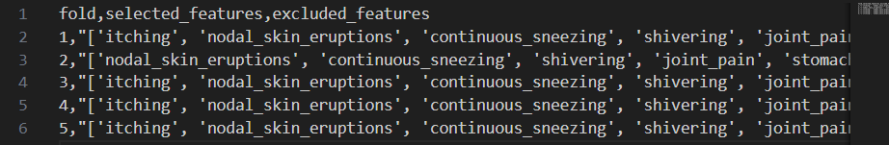
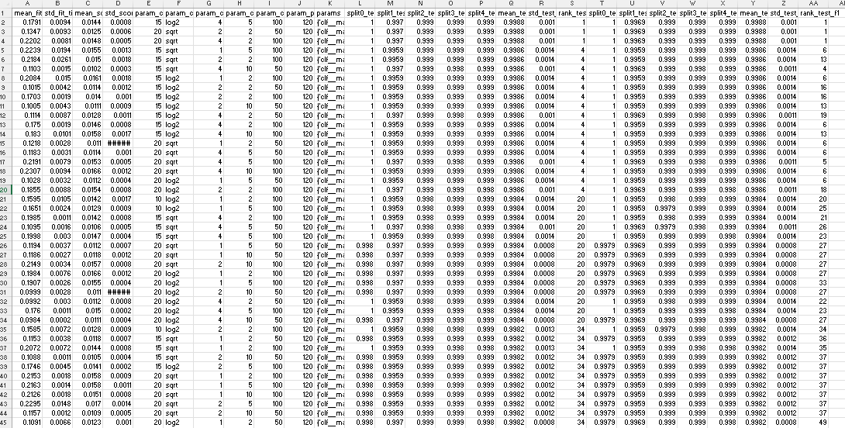
DATA organization and output

Slide 10
Output example
MODEL USED: Random Forest
Symptom Set (80): Accuracy = 0.7427, F1 = 0.7324
Symptom Set (90): Accuracy = 0.8654, F1 = 0.8604
Symptom Set (100): Accuracy = 0.9065, F1 = 0.8960
Symptom Set (110): Accuracy = 0.9481, F1 = 0.9386
Symptom Set (120): Accuracy = 0.9988, F1 = 1

Slide 11
FUTURE DIRECTIONS
Hyperparameter Optimization: Refined selection of model parameters to improve performance on reduced symptom sets.
Metrics Optimization: The dataset is dominated with infectious diseases necessitating a particular focus to minimizing false negatives. Therefore, precision and recall can be evaluated to optimize model selection.
Validation: Reduced symptom set validation can be refined using a larger testing set.
Interpretability: Expanding the range of explainability techniques to enhance model transparency for clinical applications.

Slide 12
Conclusion
We were able to build a team and work effectively as a team, collaborate, brainstorm, organize and deliver
We were able to leverage skills learned in several modules, including Git, Bash, Python, Statistical analysis, Production, Deep Learning
We were able to propose a reasonable business case and find a way to address it through logical solution
We were able to work with a dataset, understand the data, get it ready for processing, build models, visualize and evaluate them using various approaches
We were able to complete task on time and tell a story about the project, ideas, implementation and outcome

